Slide 1
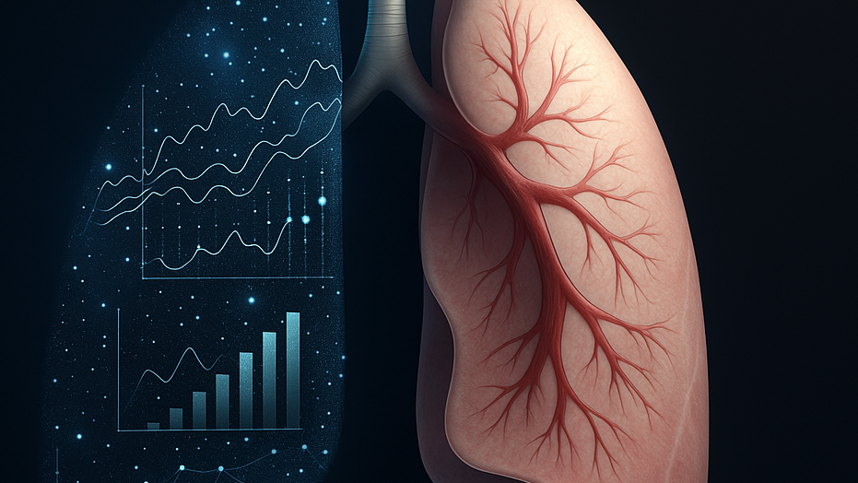
Detecting Smokers Using Health Data
Ahmed AlSaeed

Slide 2
The Problem Statement & Target Audience
The Problem:
Smoking affects many health indicators but people do not always report whether they smoke or not.
This makes it difficult for healthcare providers to detect early risks or understand a patient’s real health condition.
Key Question:
Can we identify if a person is a smoker only from their medical test results?
Target Audience:
Healthcare Sector.
Doctors.

Slide 3
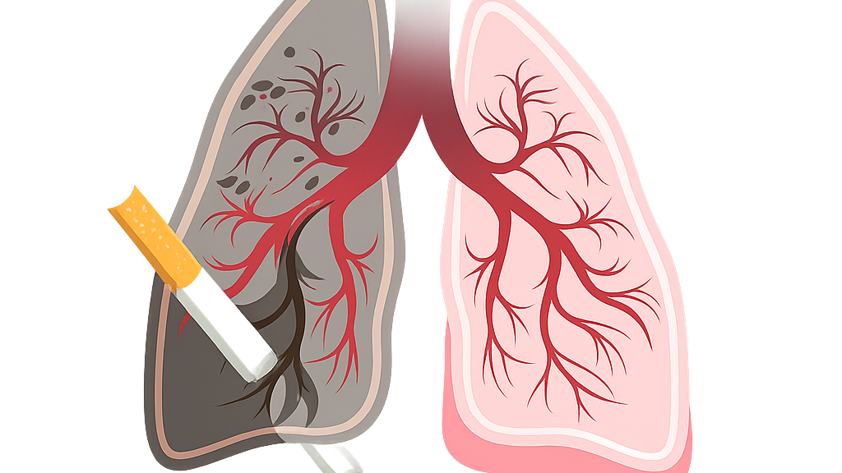
Dataset Overview
Total records: 55,692 individuals.
Smokers: 20,455.
Non smokers: 35,237.
Gender: 35,401 Males and 20,291 Females.
No individuals below age 18 are smokers.
In all Charts: Orange = Smokers, Green = Non smokers.

Slide 4
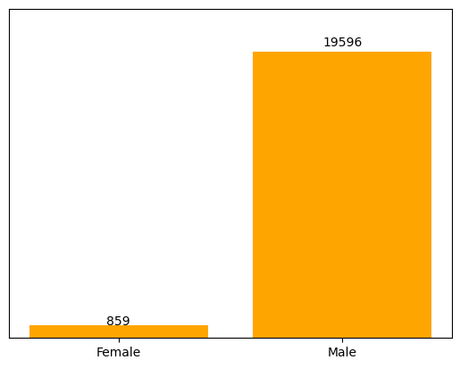

Males Smoking more than Female

Slide 5




External Effects
z

Slide 6
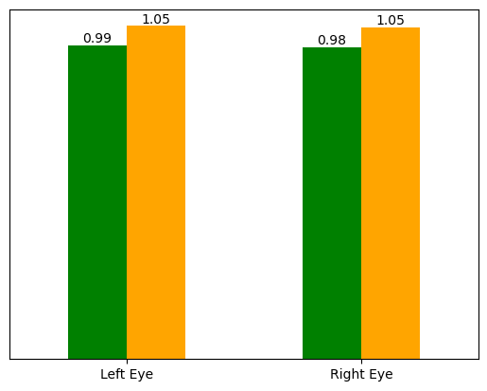
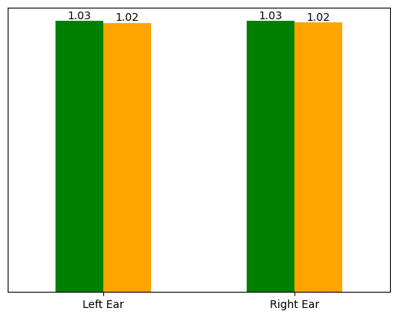
Smoking Affects Eyesight but not Hearing

Slide 7
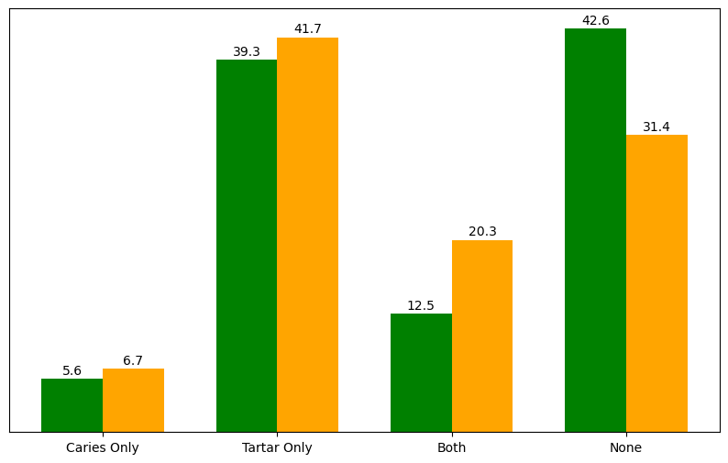

Smokers have Higher Tartar and Combined Dental Issues

Slide 8

Blood Test

Slide 9
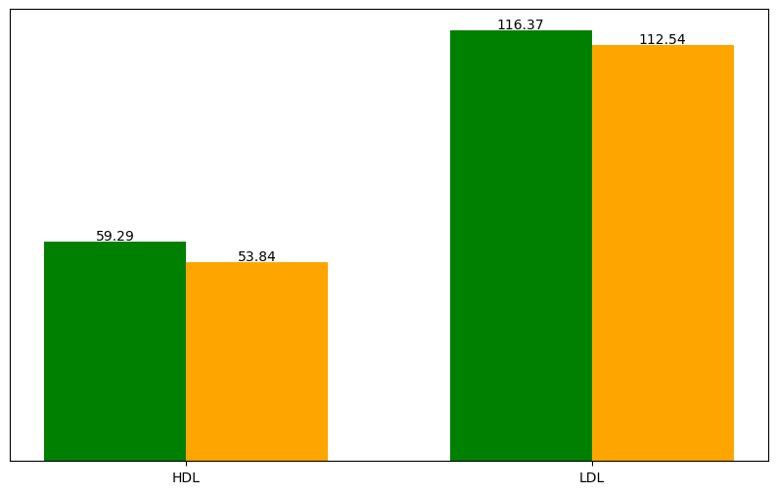
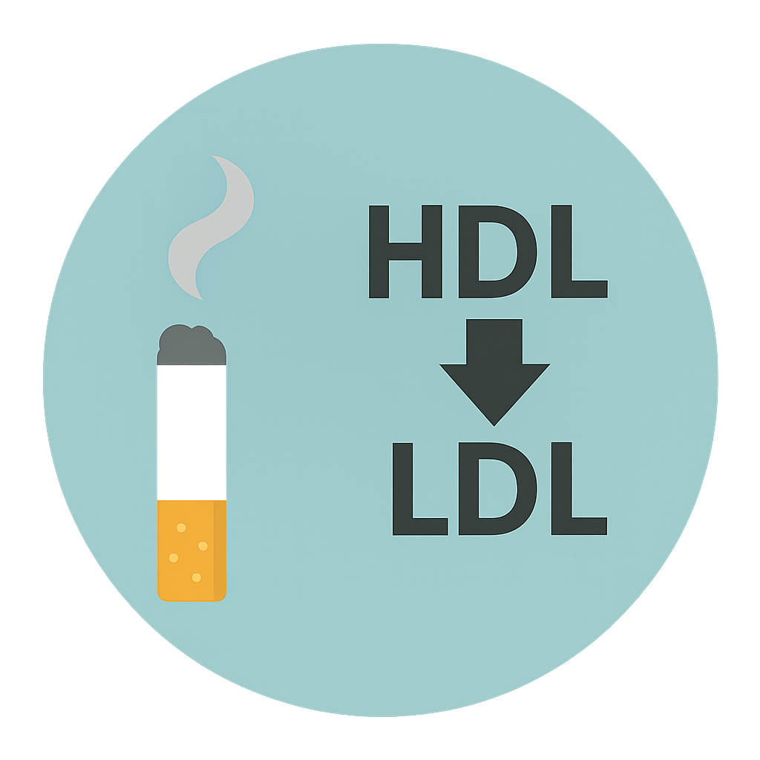
Smokers have Lower HDL and LDL

Slide 10
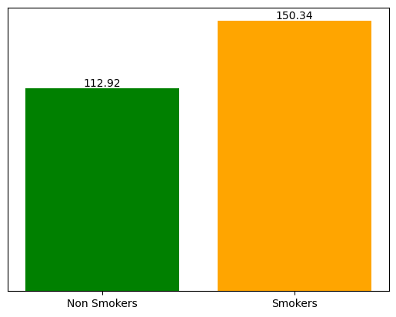
Smokers have Higher Triglyceride Levels

Slide 11
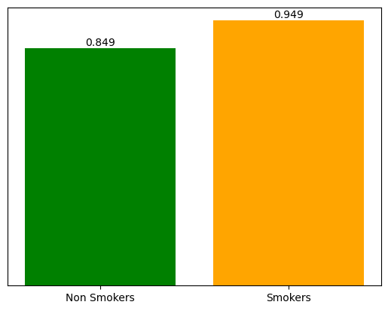

Smokers have Higher Serum Creatinine Levels

Slide 12
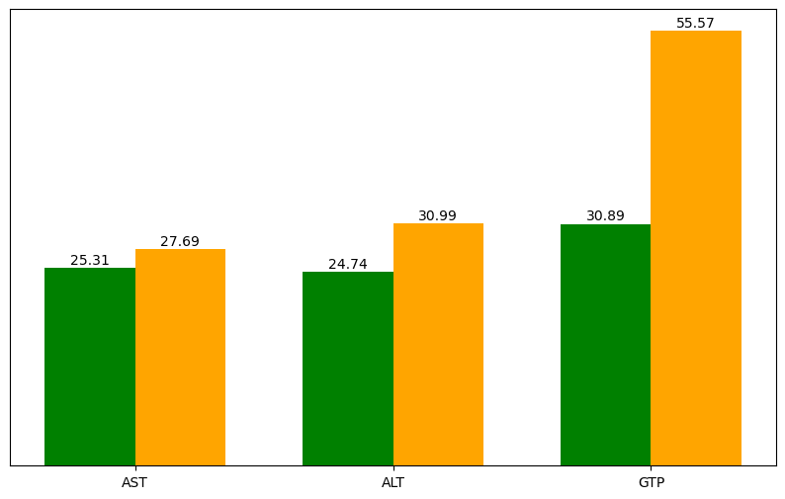
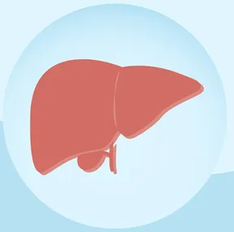
Smokers have Higher Liver Enzyme Levels -GTP Shows the Biggest Increase

Slide 13
Recommendation
Doctors should focus on the key smoking related results: Triglycerides, GTP and HDL.
Hospitals can add these patterns to their systems so doctors get automatic alerts.
If these smoking patterns appear in the tests, the patient should do extra liver and kidney checks to catch any early problems.
Patients with abnormal results should be encouraged to join stop smoking programs, even if they say they don’t smoke.

Slide 14

Thank You

